Slide 1
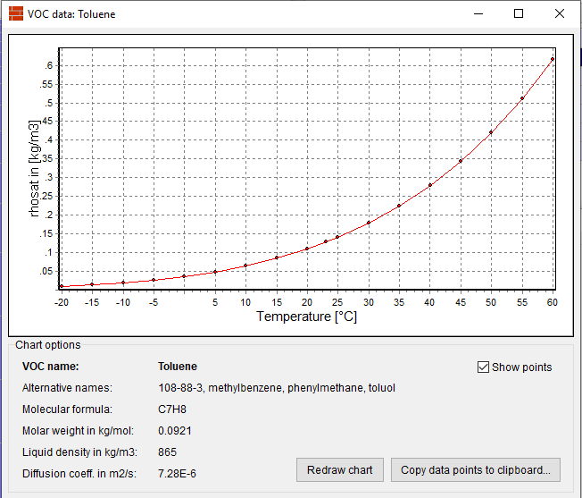
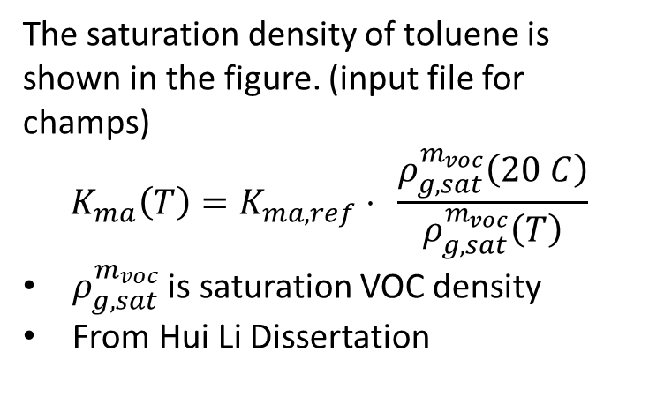
In order to verify how the champs-bes correlate the Kma with temperature difference, I tested 3 simple cases with different temperature levels
Case1: Material only
Case2: Small chamber emission test (Example from MAE 658 blackboard)
Case3: Dual chamber test (Example from MAE 658 blackboard)
There are 2-3 temperature levels for each case (details in following slides). All settings are same between different temperature levels, except the temperature.
The saturation density of toluene is shown in the figure. (input file for champs)
$$K_{ma}\left(T\right)=K_{ma,ref}⋅ \frac{ρ_{g,sat}^{m_{voc}}\left(20 C\right)}{ρ_{g,sat}^{m_{voc}}\left(T\right)}$$
$ρ_{g,sat}^{m_{voc}}$ is saturation VOC density
From Hui Li Dissertation

Slide 2
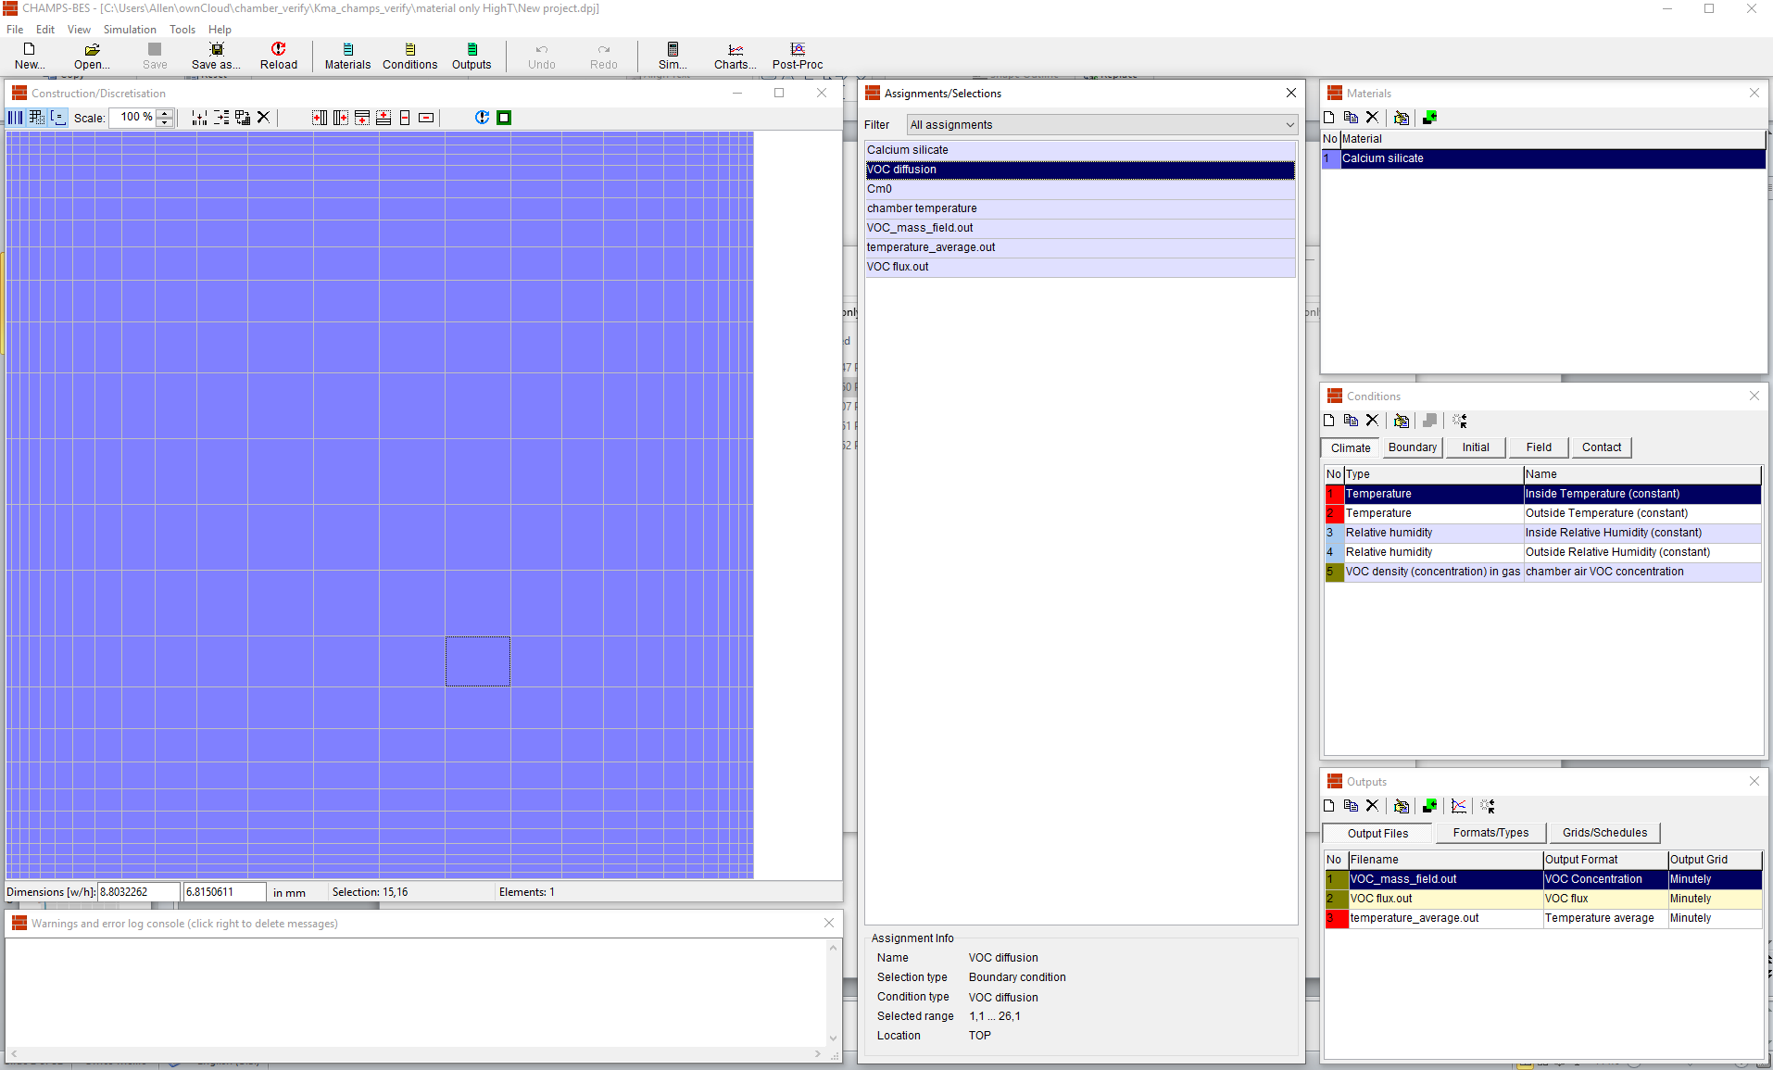
Case1: Material only
Champs setup:
Add diffusion boundary condition on the top surface of material
Air concentration is 0 ug/m^3.
Test 2 cases Temp =20 C and Temp =50 C

Slide 3
Case1: Material only
Temperature
50
40
Temperature, C
reference T
High T
30
20
0
2000
Time, min
4000
6000

Slide 4
0.30000
0.29995
VOC flux, ug/m^2*h
Reference T
0.29990
High T
0.29985
0
2000
Time,min
4000
6000

Slide 5
Summary:
The manually calculated Kma is 0.26 of reference value. (120 at 20C, 31.2 at 50C)
The VOC flux under temp =20 C and temp =50 C are coincide in the figure.
The flux does not present the effect by Kma.

Slide 6
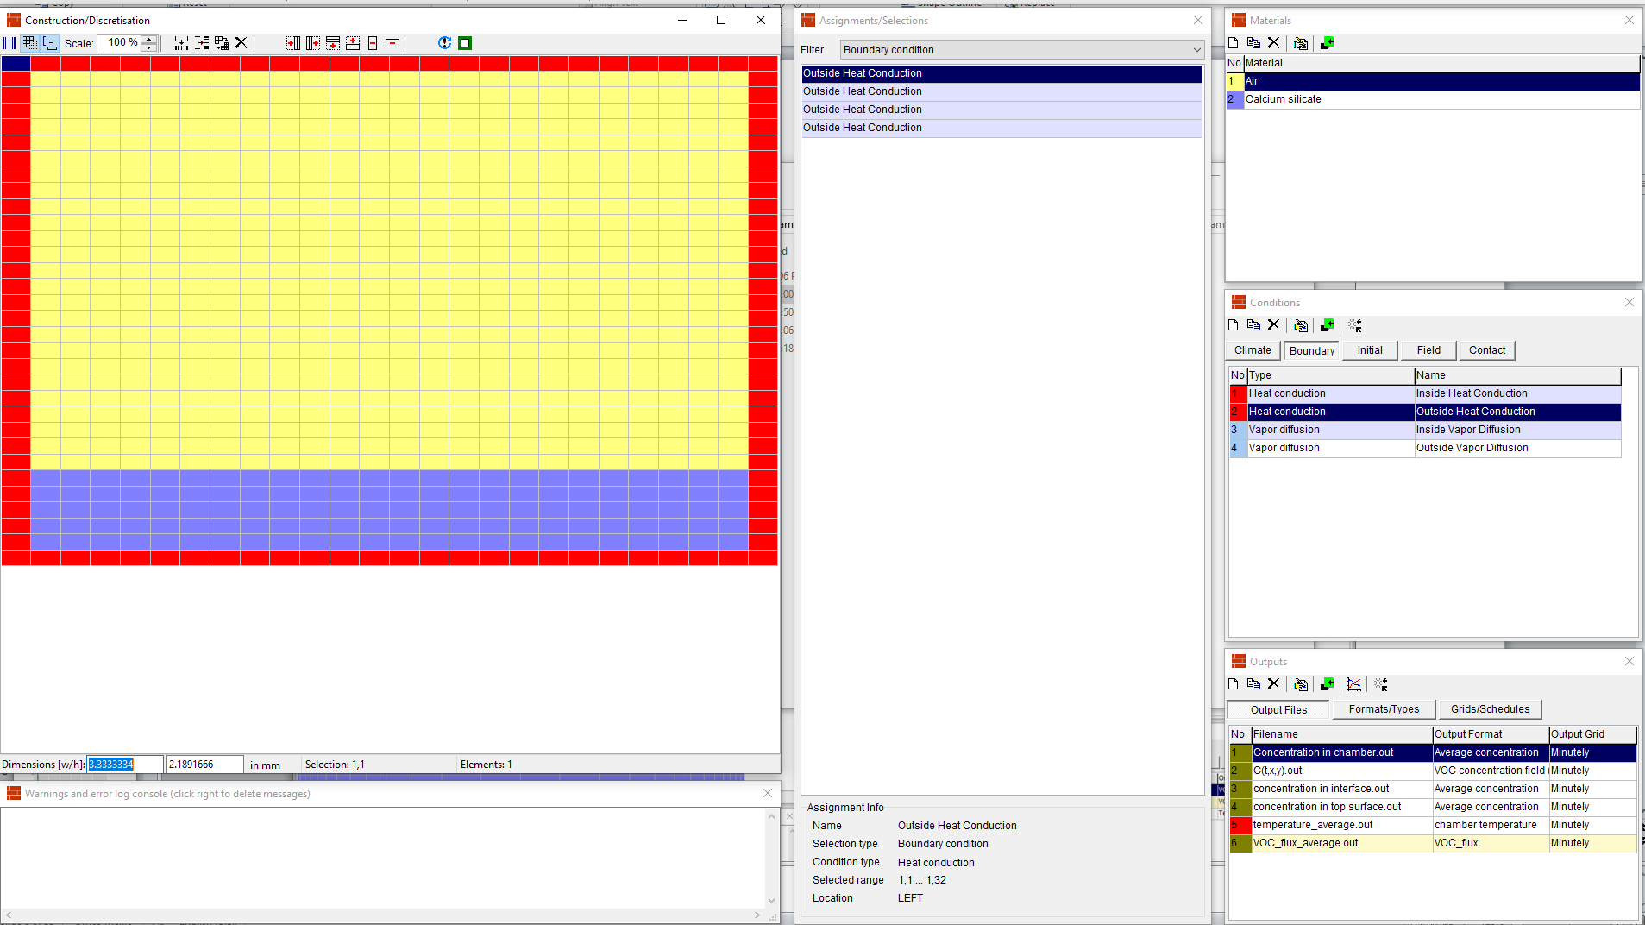
Case2: Small Chamber Test
Champs setup:
Test 3 cases Temp =20 C, 50 C and sine wave fluctuation temperature
Temperature boundary condition to maintain or fluctuate temperature.
Output the VOC concentration in bottom layer of air and top layer of material to calculate the Kma.
Other setting (Ca(0), Ca(supply), ACH) are same as chamber test. Cm =100 mg/m^3.

Slide 7
Case2: Small Chamber Test
Temperature
50
40
Temperature, C
reference T
30
High T
Fluctuation T
20
10
0
100
Time, min
200
300

Slide 8
Calculated Kma:
145
140
125.00
135
124.75
Kma
reference T
High T
124.50
Fluctuation T
124.25
130
124.00
2
3
4
5
6
Time
Zoom in
125
0
2
Time,hours
4
6

Slide 9
Summary:
The manually calculated Kma is 0.26 of reference value. (120 at 20C, 31.2 at 50C)
The Kma shown in figure is no significant difference between 20C and 50C.
The fluctuation of Kma shown in figure is very small compared with manually calculation. (Kma fluctuate from 74 to 204 with temperature fluctuate from 10 to 30C.
4. Figure (right) shows the VOC flux through the top surface of material. Slightly difference between difference temperature levels.
5. The Kma on previous slide does not show the difference between 20C and 50C temperature cases, but fluctuated with temperature fluctuation which can proof the fluctuation is from the VOC concentration effected by Dm and Dair, not Kma.
0.15
0.030
0.025
0.10
0.020
reference T
High T
Fluctuation T
VOC flux, ug/m^2*h
reference T
0.015
High T
Fluctuation T
0.010
0.05
100
150
200
250
300
Zoom in
0
100
Time, min
200
300

Slide 10
Case3: Dual chamber with Temp =23C
Use the champs file from blackboard directly
Output:
VOC concentration in air
VOC concentration in two sides of material
VOC flux through the material
Kma calculated by ratio of interface concentration

Slide 11
23
Temperature, C
23
23
0
1000
Time,min
2000

Slide 12
2000000
1500000
VOC concentration in air
chamberA
1000000
chamberB
500000
0
0
10
20
Time,hours
30
40

Slide 13
2e+08
VOC concentration in two sides of material
chamberA
chamberB
1e+08
0e+00
0
10
20
Time,hours
30
40

Slide 14
6e+05
5e+05
4e+05
VOC flux
chamberA
chamberB
3e+05
2e+05
1e+05
0
1000
2000
Time,min

Slide 15
125.0
122.5
Kma
chamberA
120.0
chamberB
117.5
0
10
20
Time,hours
30
40

Slide 16
Case3: Dual chamber with fluctuate Temp.
Only change the heat boundary condition from constant to sine wave

Slide 17
30
25
Temperature, C
20
15
0
1000
Time, min
2000

Slide 18
2000000
1500000
VOC concentration in air
chamberA
1000000
chamberB
500000
0
0
10
20
Time, hours
30
40

Slide 19
2e+08
VOC concentration in two sides of material
chamberA
chamberB
1e+08
0e+00
0
10
20
Time,hours
30
40

Slide 20
6e+05
5e+05
4e+05
VOC flux
chamberA
chamberB
3e+05
2e+05
1e+05
0
1000
2000
Time, hours

Slide 21
125.0
122.5
Kma
chamberA
120.0
chamberB
117.5
0
10
20
Time, hours
30
40

Slide 22
Conclusion:
All the cases give the reasonable simulation if ignore the effect of temperature.
The change of VOC flux and concentration is due to Dair and Dm, not Kma.
Kma does not correlated by temperature with current settings.
Warning message shows “Gas phase density not calculated, though required for VOC output!”. I guess this is the reason.

Slide 23
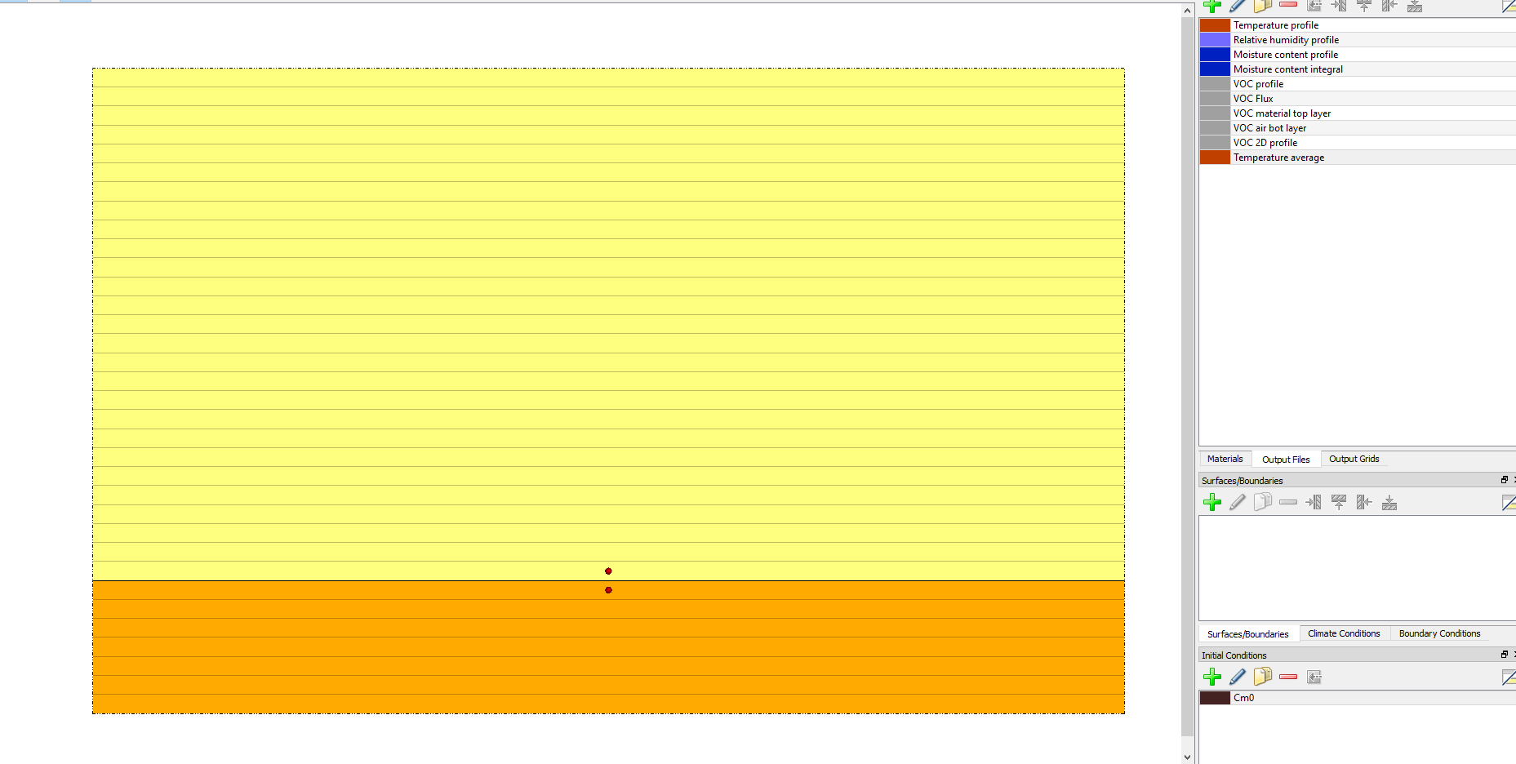

Slide 24
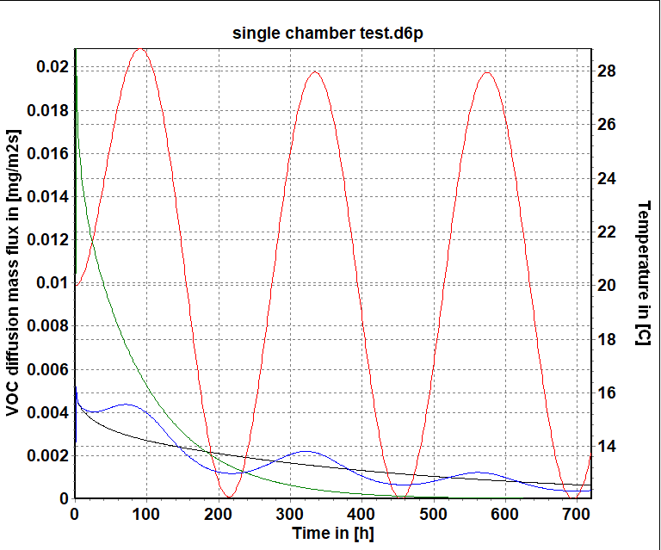
Red: temperature
Black: reference condition
Green: high temperature
Blue: fluctuation

Slide 26
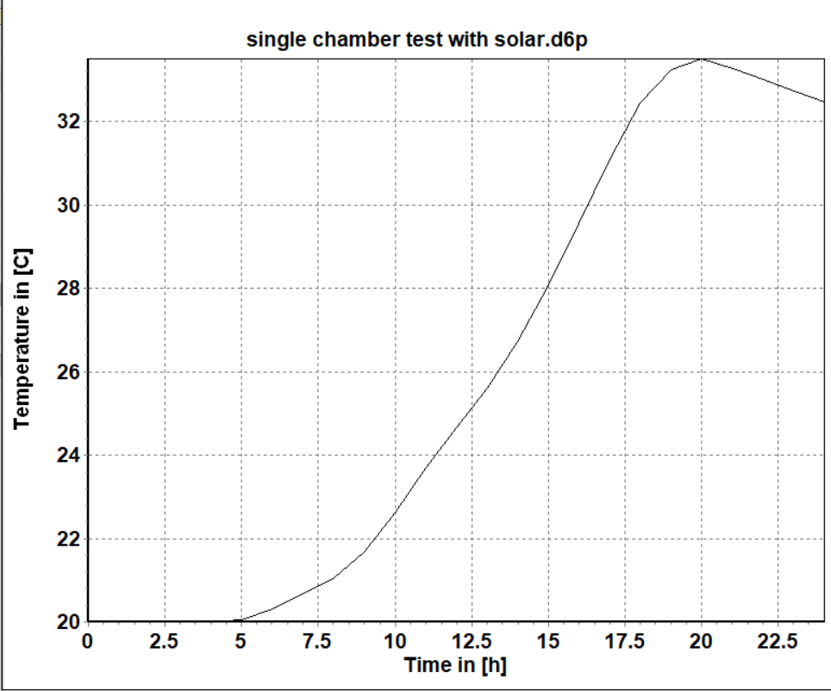

Slide 27
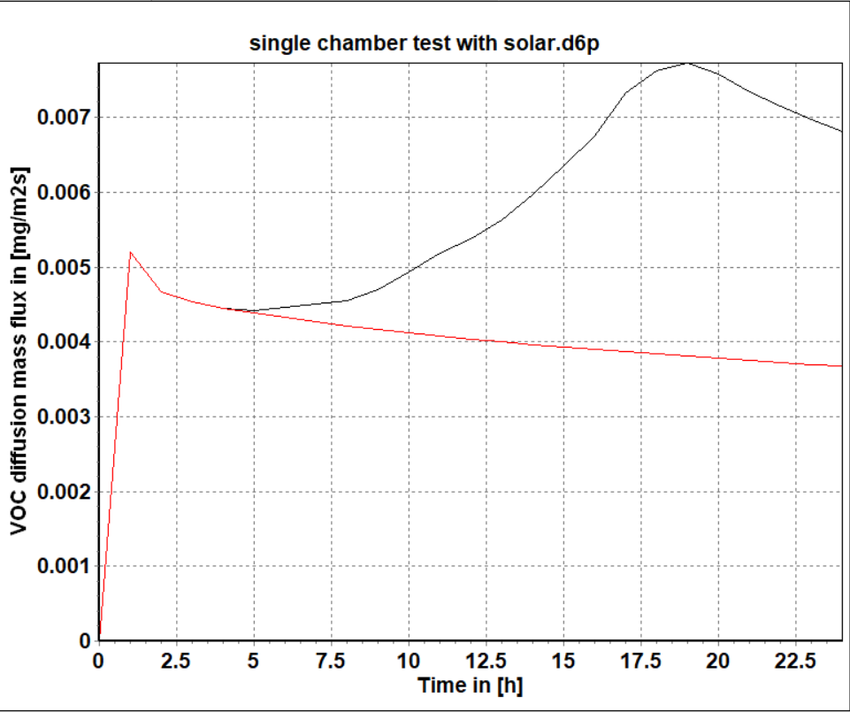

Slide 28
